Slide 1
Delayed Sleep Phase Syndrome and CRY1 gene
Sara Acosta Villarreal

Slide 2
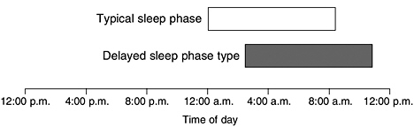
What is Delayed Sleep Phase Disorder (DSPS)?
Notes:
Delayed sleep phase syndrome (DSPS) is a circadian rhythm sleep disorder, in which a person has the propensity of sleeping and waking at later hours than conventional times of the day [1]. DSPS can inhibit the ability to be well-rested and awake at desired times for work or school. Individuals with DSPS can achieve normal sleep quality and quantity when allowed to choose their schedule. Typical times for individuals with delayed sleep phase to go to bed are between 1 and 4 am, and wake up are between 8 and 11 am [2].​

Slide 3
What are the signs of DSPS?
Depression
Trouble falling asleep
Behavioral problems
Inability to wake up at desired time (school, work)
Notes:
Typical symptoms of DSPS include:
Delay in sleep pattern based on wanted sleep and wake schedule
Trouble falling asleep at desired time of night
Inability to wake up at desired or socially acceptable time​
Depression and behavior problems
When allowed to follow their own sleep schedule, sleep length and quality is normal
Delayed sleep time lasts for at least seven days​
Depression and behavior problems

Slide 4
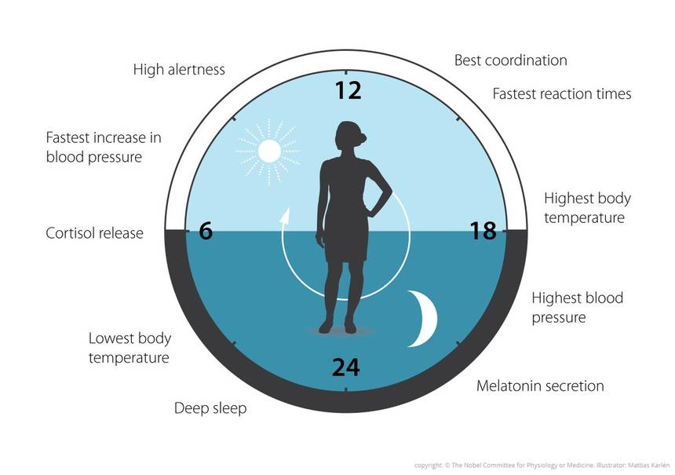
What is the Circadian Clock?
Notes:
A molecular circadian clock governs rhythmicity within an organism - the sleep:wake cycle of an organism: bats waking up as the sun sets and plants positioning their leaves to catch sunlight in the morning. Circadian clocks are synchronized to the 24-hour patterns of lights and temperature as the earth rotates. Circadian clocks regulate body temperature, blood pressure, hormones, and metabolism rhythms among other processes even in the absence or interruption of light:dark cycles.

Slide 5
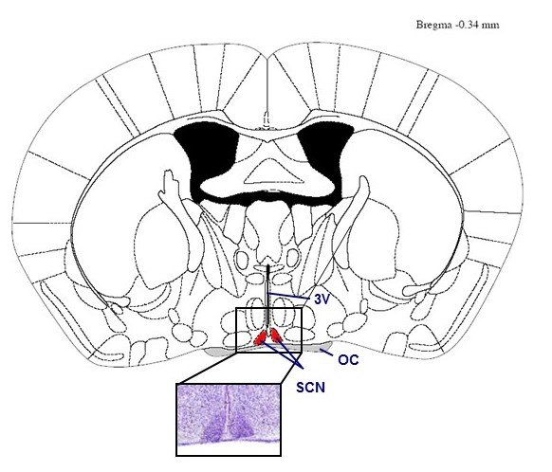
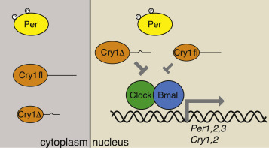
CRY1 gene is associated with DSPS
FAD binding domain
Photolyase
632 AA
Cellular Component
Molecular Function
Biological Process
Transcriptional Repression
BMAL1-CLOCK
SCN; cell nucleus
Notes:
Consists of two major components: the central clock, residing in the suprachiasmatic nucleus (SCN) of the brain, and the peripheral clocks that are present in nearly every tissue and organ system.

Slide 6
CRY1 is well conserved among species
Human
Photolyase
FAD binding domain
632 AA
Chimpanzee
632 AA
Mouse
606 AA
Rat
588 AA
Elephant
583AA
Zebrafish
556 AA
Fruit Fly
540 AA
Arabidopsis thaliana
445 AA

Slide 7
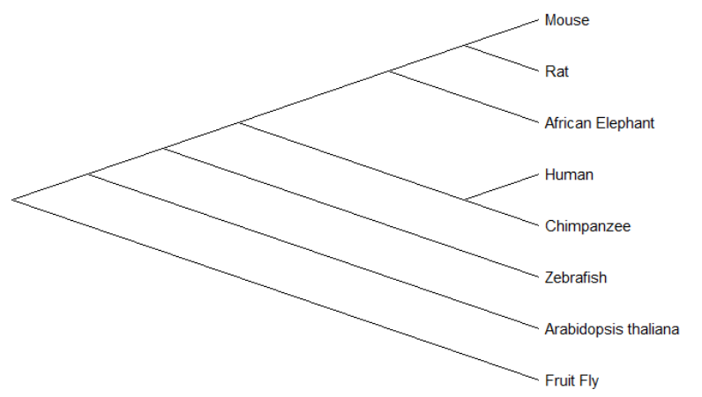
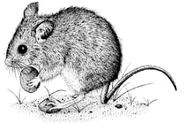
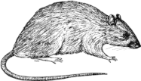
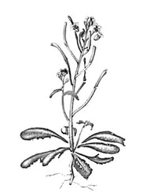
CRY1 is conserved in species

Slide 8
How to study CRY1?
Suprachiasmatic Nucleus
Suprachiasmatic Nucleus

Slide 9
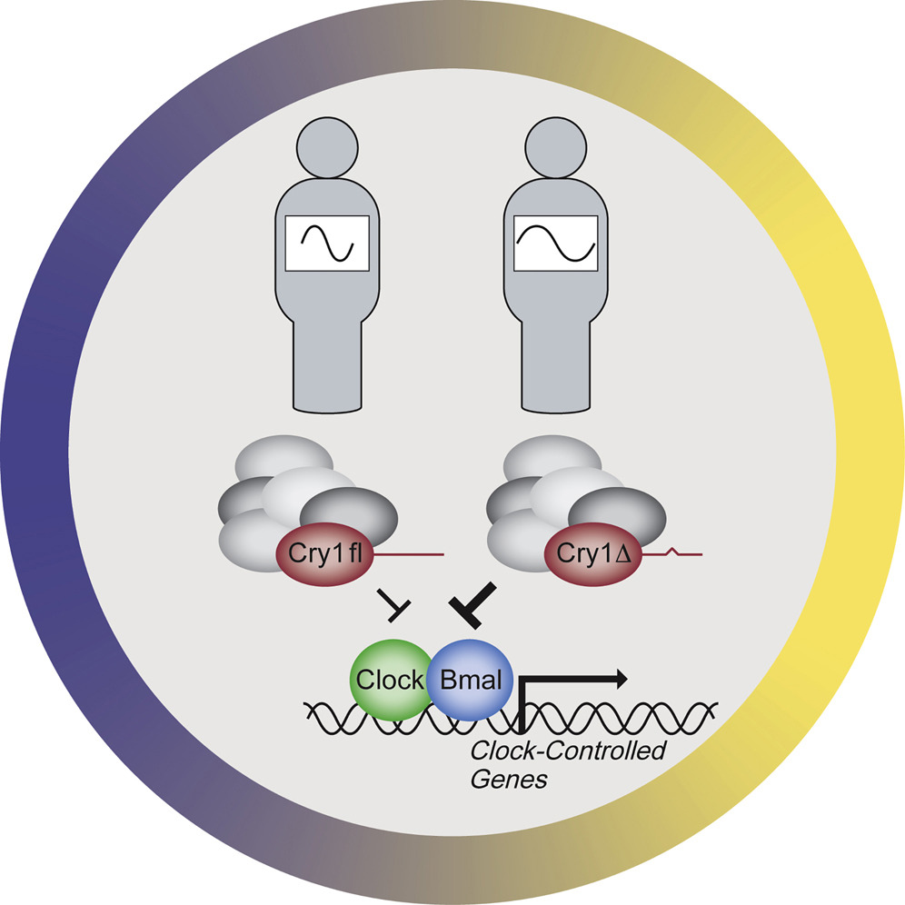
Gap in Knowledge
Notes:
Why is the deletion in exon 11 on chromosome

Slide 10
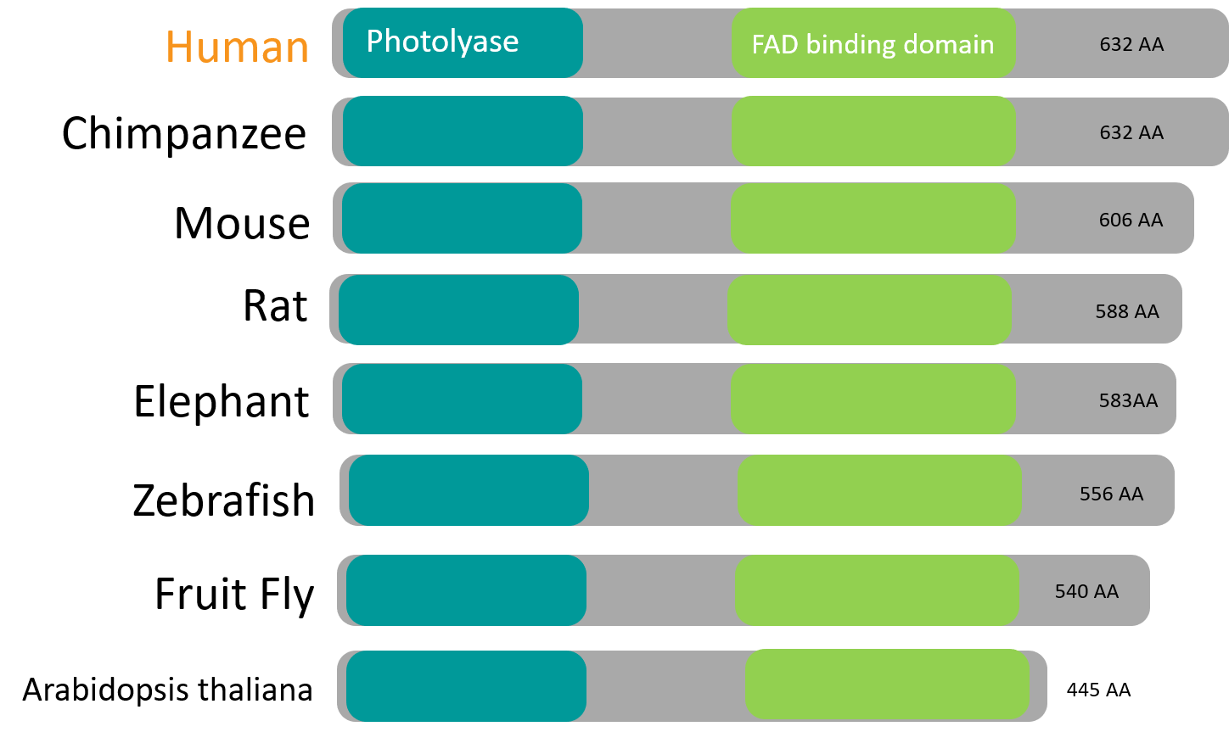
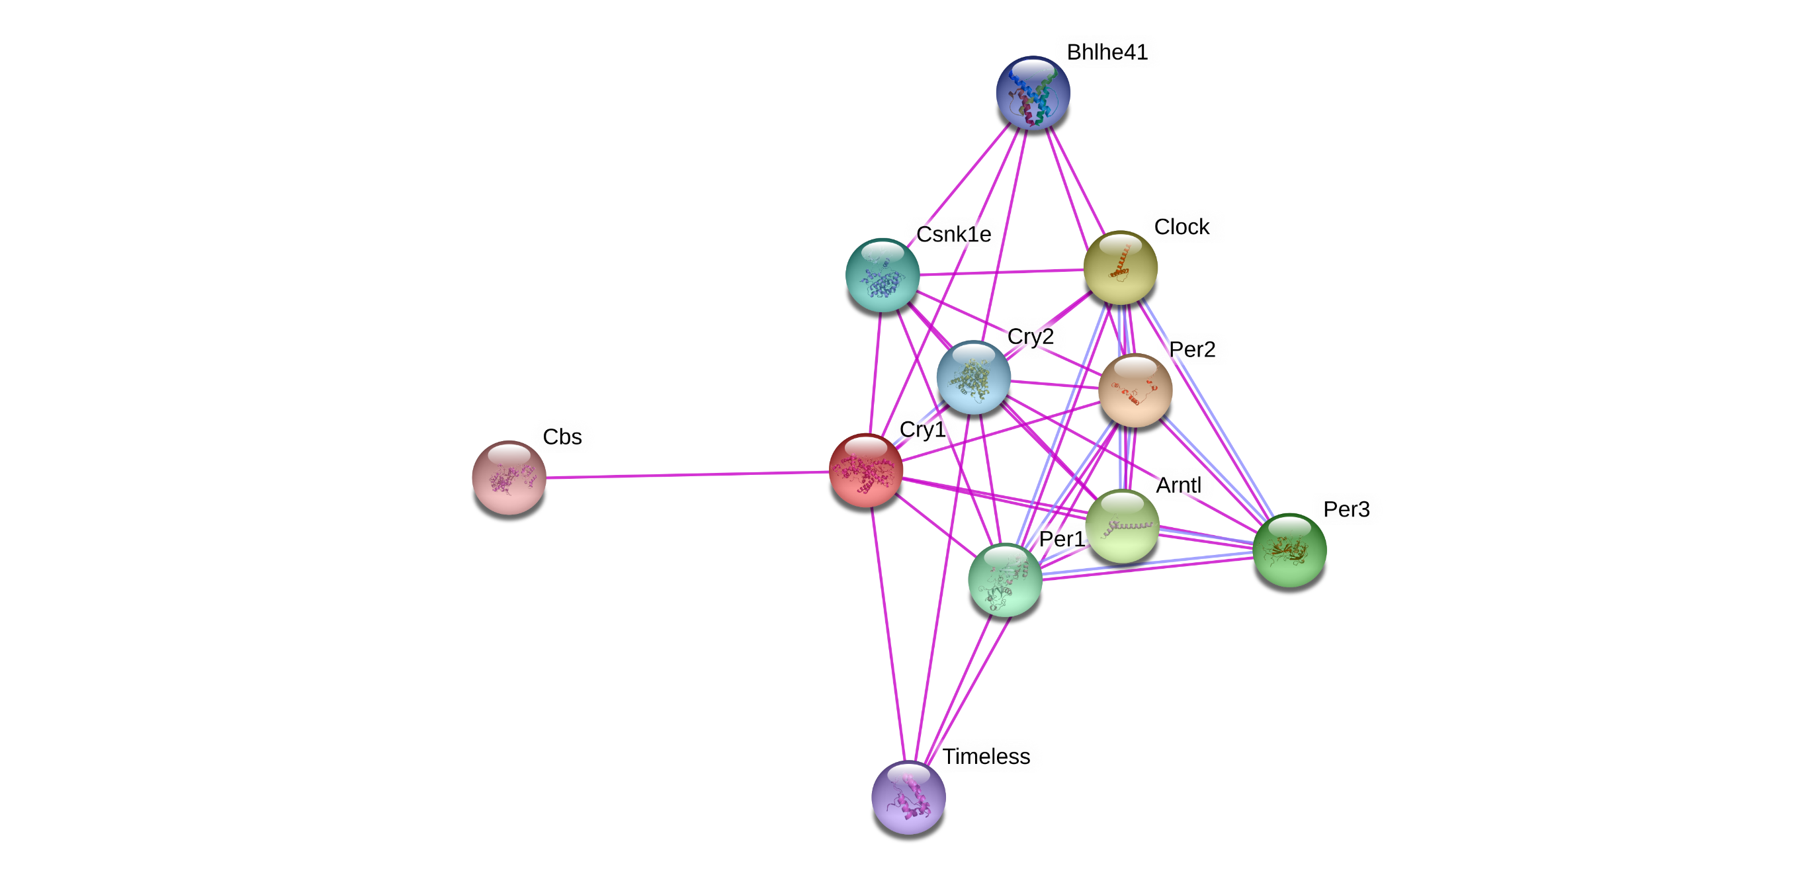
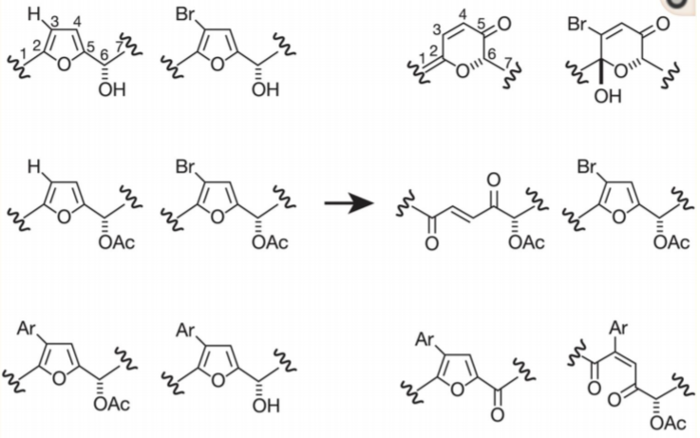
What is my primary goal?
To understand the role of phosphorylation of the Cry1 protein tail in the regulation of the circadian clock.
Aim 1
Aim 2
Aim 3
Determine amino acid conservation between normal and mutant lines
Establish protein interactions with mutant line
Identify interaction of mutant lines with chemical compounds

Slide 11
Aim 1
Determine conserved amino acids of CRY1 and mutant sequences to determine effects of deletion.
CRISPR/Cas9
Screen
Clustal Omega
Photolyase
FAD binding domain
Notes:
Create mutagenic mouse line, or zebrafish(?) for chemical compound
lines with a 72 base pair deletion on the Cry1 gene on chromosome 10: Cry1-/Cry1- and Cry1+/Cry1-
EXPLAIN REGIONS, WHAT IS PHOTOLYASE, WHAT IS FAD binding domain?

Slide 12
Aim 1
Determine conserved amino acids of CRY1 and mutant sequences to determine effects of deletion.
CRISPR/Cas9
Screen
Clustal Omega
WT
Mutagenic Cry1 Δ11
Notes:
Create mutagenic mouse line, or zebrafish(?) for chemical compound

Slide 13
Aim 1
Determine conserved amino acids of CRY1 and mutant sequences to determine effects of deletion.
CRISPR/Cas9
Screen
Clustal Omega
Notes:
Create mutagenic mouse line, or zebrafish(?) for chemical compound

Slide 14
Aim 2
Establish protein interactions resulting from mutations in CRY1.
CRISPR/Cas9
TAP tag or
Mass Spec
GO terms for interactions
Creation of Mutagenic Cry1 Δ11 lines

Slide 15
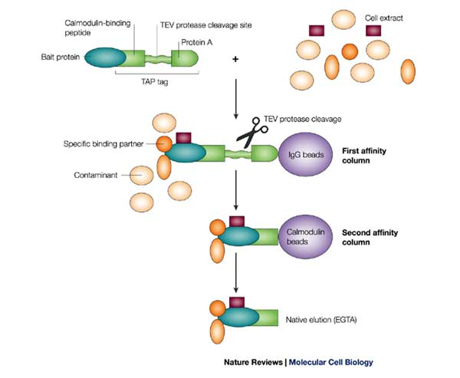
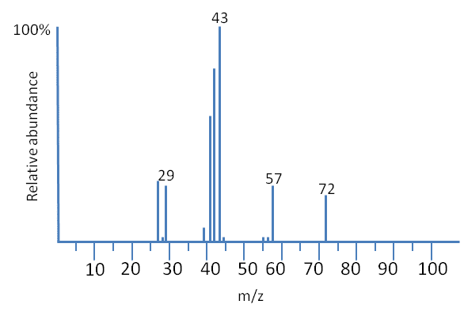
Aim 2
Establish protein interactions resulting from mutations in CRY1.
CRISPR/Cas9
TAP tag or
Mass Spec
GO terms for interactions

Slide 16
Aim 2
Establish protein interactions resulting from mutations in CRY1.
CRISPR/Cas9
TAP tag or
Mass Spec
GO terms for interactions
?

Slide 17
Aim 3
Identify chemical compounds that will interact with and potentially repress the effects of CRY1 tail deletion.
Assemble chemical library
Protein binding assay
Phenotypic Screen
Notes:
Reverse chemical genomics

Slide 18
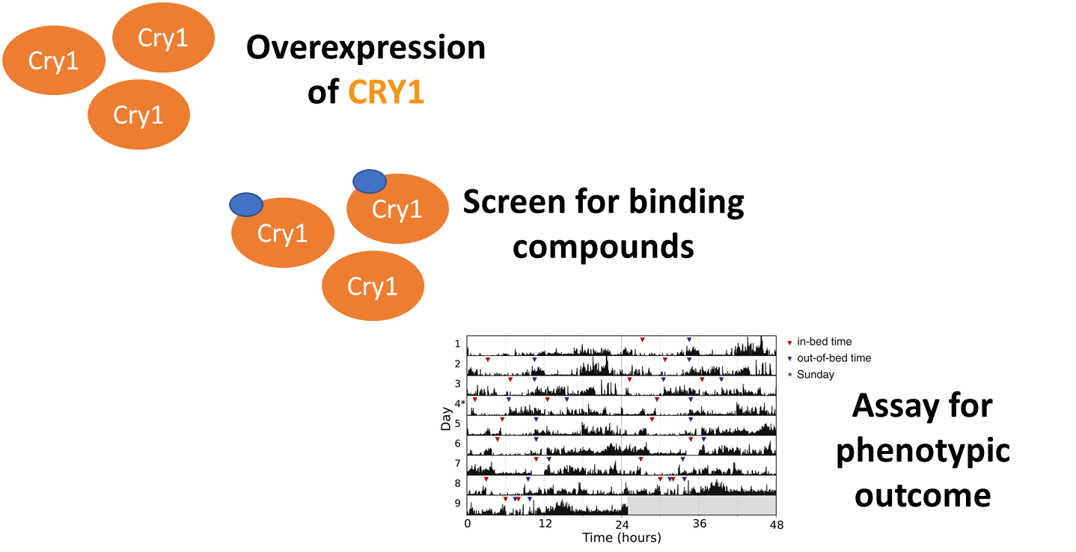
Aim 3
Identify chemical compounds that will interact with and potentially repress the effects of CRY1 tail deletion.
Assemble chemical library
Protein binding assay
Phenotypic Screen

Slide 19
Aim 3
Identify chemical compounds that will interact with and potentially repress the effects of CRY1 tail deletion.
Assemble chemical library
Protein binding assay
Phenotypic Screen

Slide 20
Summary
A deletion in CRY1 gene results in the overexpression of the protein and lengthening of the circadian cycle.
The study of mutagenic lines allows for the study of protein interactions in diseased states.
Understanding the mechanisms behind the CRY1 protein tail will allow for the development of therapies and treatment for circadian rhythm disorders.

Slide 21
References
Database, G. H. G. (2019). CRY1 Gene - GeneCards | CRY1 Protein | CRY1 Antibody.
Delayed Sleep Phase Syndrome (DSPS) in Children and Adolescents | Cleveland Clinic. (2019). Retrieved from https://my.clevelandclinic.org/health/diseases/14295-delayed-sleep-phase-syndrome-dsps-in-children-and-adolescents
Gao, P., Yoo, S. H., Lee, K. J., Rosensweig, C., Takahashi, J. S., Chen, B. P., & Green, C. B. (2013). Phosphorylation of the Cryptochrome 1 C-terminal Tail Regulates Circadian Period Length*. In J Biol Chem (Vol. 288, pp. 35277-35286).
Medicine, A. A. o. S. (2019). Delayed Sleep-Wake Phase – Overview & Facts. Retrieved from http://sleepeducation.org/sleep-disorders-by-category/circadian-rhythm-disorders/delayed-sleep-wake-phase/overview-and-risk-factors
Patke, A., Murphy, P. J., Onat, O. E., Krieger, A. C., Ozcelik, T., Campbell, S. S., & Young, M. W. (2017). Mutation of the Human Circadian Clock Gene CRY1 in Familial Delayed Sleep Phase Disorder. Cell, 169(2), 203-215.e213. doi:10.1016/j.cell.2017.03.027
Zhu, H., Conte, F., & Green, C. B. (2003). Nuclear localization and transcriptional repression are confined to separable domains in the circadian protein CRYPTOCHROME. Curr Biol, 13(18), 1653-1658.

